Slide 1
accreditation update Fall 2019
Preparing for the Site Visit

Slide 2
How does the site visit fit into the overall accreditation process?

Slide 3
Accreditation 101: Context for the Site Visit
An accreditation evaluation is a process through which colleges:
Demonstrate the quality of their educational programs and services to the public
Identify areas for improvement leading to more effective fulfillment of their mission
Evaluations center around a set of pre-defined standards:
Developed by ACCJC in collaboration with its member colleges
Aligned with established standards of good practices in US higher education
ACCJC accreditation involves multiple layers of evaluation:
Self evaluation, documented in an Institutional-Self Evaluation Report (ISER)
Peer evaluation, conducted by an external Evaluation Team and including a site visit
Commission evaluation, using findings from self and peer evaluation

Slide 4
Accreditation 101: Context for the Site Visit
Self Evaluation
Outcomes:
- Self-Evaluation Report (aka, ISER)
- Self-identified plans for improvement
- Quality Focus Projects
Peer Evaluation
Outcomes:
- Site visit findings
- Team report
- Drafts of potential recommendations (NB: confidential)
ACCJC Evaluation
Outcomes:
- Final recommendations
- Final commendations
- Official decision re: accreditation status

Slide 5
Where can I find a copy of the ISER?

Slide 6
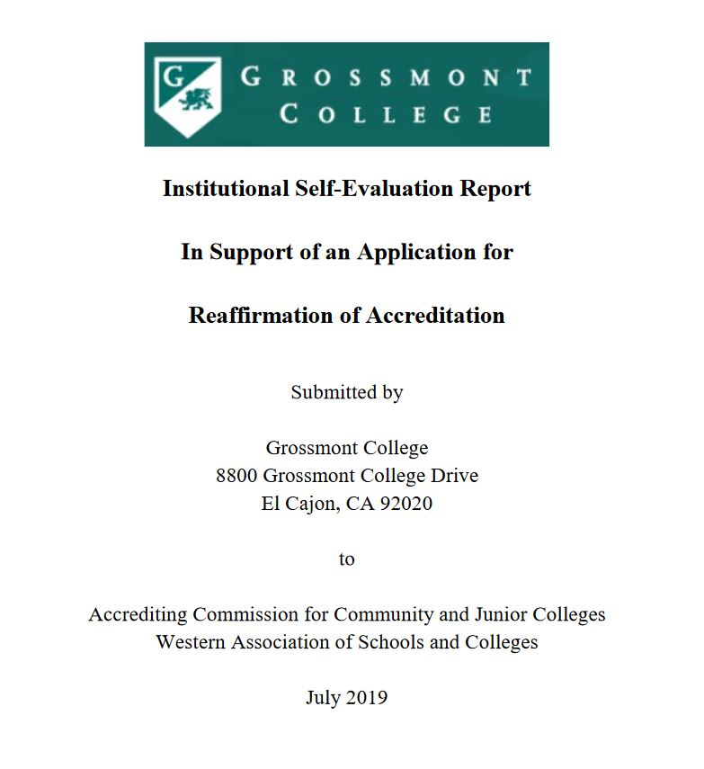
The Grossmont College ISER
Available online:
College Information > Accreditation > 2019 Site Visit
Notes:
Evidence links work best with Firefox. Evidence (*

Slide 7
Who is on the visiting team?

Slide 8
Meet the Evaluation Team
Team members are:
Faculty and administrators from other colleges accredited by ACCJC
Experienced with the Standards – through ACCJC training at a minimum
Volunteers who believe strongly in peer review and support
Teams also now include an ACCJC Liaison:
Process observer
Expert on Standards and Commission policies
Liaison between the team and the commission
Our ACCJC Liaison is Dr. Stephanie Droker
Notes:
Team members are volunteers who serve on evaluation teams because they believe very strongly in the concept of colleagues helping colleagues. They know they will learn from us, just as we learn from them.
If we enter the site visit with the mindset that the team is coming to help us identify places where we can improve, the conversations with the team will be more positive and engaging. Remember: they know we are not perfect, because no college is perfect. All team members come from colleges that are also working to improve.

Slide 9
Meet the Evaluation Team
Dr. Loretta (Lori) Adrian, Team Chair
President,
Coastline Community College
Dr. Vince Rodriguez, Team Assistant
Vice President of Instruction,
Coastline Community College

Slide 10
Meet the Evaluation Team
Dr. Marie Bruley
Professor of Mathematics
Merced College
Dr. Oscar Cobian
Vice President, Student Services
Oxnard College
Mr. Mark Greenhalgh
Dean, Mathematics and Computer Science
Fullerton College
Dr. Kim Morrison
Library Coordinator / Information Literacy and Outreach Librarian
Chabot College
Dr. Molly Senecal
Dean, Planning and Research
Folsom Lake College
Dr. Robert Curry
Associate Superintendent / Vice President, Academic Affairs
Allan Hancock College
Mr. Kelly Enos
Professor of Criminal Justice
Los Angeles Mission College
Mr. Mark Lane
Vice Chancellor of Administrative Services
Leeward Community College (HI)
Dr. Reagan Romali
Superintendent / President
Long Beach City College
Notes:
Each team member will have a separate assignment, focusing on a different Standard or area. For example: the librarian will likely be assigned to evaluate the library standard. Someone will be assigned to evaluate Distance Education, which spans across multiple standards.
Catherine anticipates that we will know who is assigned to what prior to the visit. We’ll share this information (and pictures and bios of team members) as it becomes available.

Slide 11
What will the team do while they’re here?

Slide 12
Visit Week Overview
Monday, Sept 30
Team arrives on campus and begins to get oriented
Team members conduct interviews with District Services personnel
Tuesday, Oct 1 & Wednesday, Oct 2
Team members conduct interviews
Open forums with the team for faculty and staff
Team continues work on their report during the day and throughout the evening
Thursday, Oct 3
Exit Report Forum with the Team at 1:00pm
Team departs immediately after the Exit Report
Notes:
Team will arrive in El Cajon on Sunday and meet for a team dinner. On Monday, a few members of our team and Cuyamaca’s team will begin the portion of the evaluation related to District Services. They hope to be finished with the District interviews by noon on Monday.

Slide 13
During the Visit
Team members will
As to interview Grossmont College personnel, based on function and role E.g., “Academic Affairs deans,” “the DE team,” “Student Services front counter staff”
Team members might
Ask to sit in on a class
Ask to observe a committee meeting
Notes:
Team members will be conducting interviews while they are here on campus. The team will request interviews based on questions they have after reading our ISER. If you are invited to an interview, Catherine & Bernadette will let you know in advance – but in the meantime, please plan to be present and flexible during the visit week – especially if you represent a key area written about in the ISER.
The team members will be working in Griffin Gate, but moving around the campus freely. They may stop to chat with you. Be hospitable – remember, they’re guests volunteering their time to support us. They may ask what you do at Grossmont College, what you’re most proud of, or something you’re working to improve. Have some ideas about things you’re proud of ready to share, just in case.
Classroom visits are possible. If team members express an interest in attending a class, emphasize that Catherine & Bernadette will provide as much advance notice as possible. Teams do understand that visitors can be disruptive, and they will be respectful.
If you serve on a major committee that meets during the week of the visit, it is possible that there will be at least one team member observing. They may ask a question or two, but it is more likely that they will just observe.

Slide 14
What should we do while the team is here?

Slide 15
During the Visit
Before the visit, take time to review:
The basics of accreditation process
Standards most closely related to your area of responsibility
Accomplishments in your area– what are you most proud of?
During the visit:
Relax! Extend hospitality to team members whenever you see them
Attend open forums with the team if at all possible
If a team member asks you for any additional evidence, please:
Refer them to Grossmont’s Accreditation Liaison Officer (Catherine Webb)
Contact Catherine ASAP, at catherine.webb@gcccd.edu or x7462
Notes:
EMPHASIZE:
Team members may get enthusiastic during a conversation and ask to see evidence. That’s totally fine! Our Accreditation Liaison Officer (ALO) will handle the communication around any additional evidence requests. If someone asks for something, let them know you’ll work with Catherine to get it to them – and then contact Catherine right away so that she can follow up.

Slide 16
During the Visit
Everyone is encouraged to attend:
Open forums with members of the team
Tuesday, Oct 1: 10:00am – 11:00am, H&S Lobby (2nd Floor)
Wednesday, Oct 2: 1:30pm – 2:30pm, H&S Lobby (2nd Floor)
Exit Report Forum with the team
Thursday, Oct 3: 1:00 – 1:30pm, H&S Lobby (2nd Floor)
Notes:
Open forums are a chance to engage with the team members – to ask questions, to highlight areas of strength, and discuss how we’re working to improve. The forums provide the team with a sense of our community and culture beyond what they can read in the ISER.
The Exit Report is an opportunity to hear a high-level summary of the visit, show gratitude to the team for their time and expertise, and demonstrate to the team (and to the ACCJC) that the college is interested and engaged in the outcome. Exit report will be include fairly general information; expect broad themes, rather than specifics or details.

Slide 17
What happens after the visit?

Slide 18
Visit Outcomes & Next Steps
Exit Report
Team chair will provide a high-level summary of the visit
Exit report will NOT include team recommendations, except as broad themes
After the visit:
Team will finalize their report and draft recommendations
ACCJC will review the Team Report and our ISER in January 2020
ACCJC will officially notify Grossmont College of our status in February 2020
Notes:
CLARIFY
The team will draft recommendations based on the visit, but they will not share them with the college during the exit report (at least, they won’t if they’re following ACCJC’s instructions –this is a change ACCJC has made in the last couple of years, so faculty who were here in 2013 may ask about this.)
Dr. Abu-Ghazaleh will have a chance to review the team’s report before January, but he will ONLY be able to suggest corrections in cases where there are factual errors. This will be a confidential review; he is not allowed to share the details

Slide 19
Potential Outcomes: Accreditation Status
Fully Accredited – Warning
Fully Accredited – Probation
Fully Accredited – Reaffirmed for Seven Years
Fully Accredited – Show Cause
Fully Accredited – Reaffirmed for 18 Months
* The team provides its opinion about accreditation status as part of its findings. The Commission makes the official determination of accreditation status.
Notes:
EMPHASIZE:
We are fully accredited until we’re not. Even if we receive a sanction, we will still be fully accredited. This is also important to emphasize with students.
Any of these statuses may also include a follow-up report and/or follow-up site visit. In the event of a follow-up visit, typically the ACCJC will send a smaller team (if possible, comprised by members of the original evaluation team) – this is because the scope of a follow-up visit is limited to specific recommendations for compliance – they tend to be shorter and more focused.

Slide 20
What other questions do you have?
Notes:
Please let Catherine know of any questions!

Slide 21
Thank you!
Let’s have a great visit!
☺

